Slide 1

Meeting AstraZeneca Stakeholders
June 17, 2019

Slide 2
Agenda
1
Introduction to LatentView
2
Our Approach on Building an Enterprise Analytics Solution
3
Representative Case Studies

Slide 3
Introduction to LatentView

Slide 4


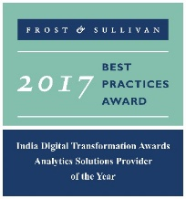




LatentView – A World Class Analytics Company
Awards & Recognition
Founded in
Over
Grown
Work with
600
11
30+
2006
Strong Performer - Customer Analytics Services, 2017
People strong
times in last
six years
Fortune 500
firms
Repeat business at
Member of
Rated as Top
2009-2017
Technology council
10
5%
4/5
>85%
Repeat
business
Analytics companies to work for in India
Re-investment in Research and Development
Top technology companies engage with us

Slide 5
The LatentView Approach
We empower customers in their digital transformation journey by helping them move up the analytics maturity curve through actionable insights that leads to
data-driven decisions
MATH
ACTIONABLE
DATA
INSIGHTS
BUSINESS
TECH

Slide 6

























Trusted Analytics Partner to the World's Most Recognizable Brands

Slide 7











Key Differentiators
Specialist in Business focused analytics
Single minded focus to create strong Impact on business metrics
33% of our people have business degree
Experts in unconventional data sources & cloud based data ecosystem
Partnership with Amazon AWS & Microsoft Azure
Microsoft’s Gold Analytics Partner
Cutting edge customizable proprietary solutions & reusable Framework
Smart Insights - External data driven trend identification platform to power product innovation
Casper – AI based self-service conservational assistant
Focus on Innovation & Thought Leadership
Institutionalized Idea Labs for innovation and research
Partnership with IIT to create IIT data labs

Slide 8
Our Approach on Building an Enterprise Analytics Solution

Slide 9
Building an Enterprise Analytics Solution
LatentView’s Workload-centric architectures help democratize insights beyond data warehousing
Workload Aware Compute
Isolating Compute from Storage for Throttle Free, Optimized, Cataloged, Secured and Accountable Single View
Data Type specific ETL toolset
CANNED REPORTS
Data Integration
Conventional Data Sources
Structured
Relational Data Store
& MPP Databases
Enterprise Reporting Platform
SELF SERVICE BI
Data Lake
Unconventional Data Sources
Indexing and Querying
API endpoints
OPERATIONAL
External Data Sources
Unstructured
Machine Learning Workbench
ADVANCED ANALYTICS
Distributed Processing
Feature Engineering
Data Sampling
Internal Data Sources
Real time Indexing
(Ex: Elastic Cache)
REAL TIME REPORTING

Slide 10
Representative Case Studies

Slide 11




Representative Case Studies
Leading Snacks & Beverages Company
Leading Home Repairs Company
Leading Pharmaceutical Company
Leading Fashion
E-Commerce
Centre of Excellence (CoE) partner to the world’s leading snacks & beverages company
Partnered with supply chain stakeholders on the key projects such as Inventory diagnostics, manufacturing stops etc.
The business has set a target to complete 95% of service requests they receive within five days of creation with an aim to improve efficiency and profitability
75% of service request resolved in 5 days. NPS improved by 400 bps. Market share up to 26.5% from 25%
Developed a comprehensive view of contracts by automatically extracting & highlighting key provisions that are important to business using ML and NLP
Automated solution for entity extraction has helped in reducing the time & cost by ~90%
Client wanted to monitor key metrics in a reliable, consistent and accurate manner for the following functional areas:
Supply Chain
Customer Experience
Platform Experience

Slide 12
Leading Snacks & Beverages Company

Slide 13










LatentView – Trusted Analytics Partner for Beverages Company
Demand Planning Disaggregation
Final Demand numbers for production
Daily Production Plan Team
Demand Resource Planning (DRP team)
Demand Planning Team
(@ Each Plant)
(Centralized Team)
(Centralized Team)
Safety Stock
numbers
Inventory Planning Team ( IVP Team)
Quantity to be produced @shift level
Warehouse2
Safety Stock Optimization
RSR giving signals to DP team
SKU Analysis & prioritization
Plant
Warehouse
Distribution Centre
Retail Stores
32 Plants
132 DCs
Service Metric Team planning the service level
Vend Customers
Manufacturing Stops
Source Based Fill
Rate Analysis
Automated Inventory Diagnostics
Warehouse Capacity Analysis
Film Waste
Analysis
Away from Home – Fill Rate Deep Dive
Award of Excellence Analysis
Fill Rate Execution Deep Dive Analysis
Carton Box Exploration
Plant Cut Fill Rate Investigation
Days On Hand Calculation Optimization*
*-Inventory Related Metric
Completed Projects
Product Flow
Information Flow

Slide 14
Business Impact and Future Roadmap
Average total number of faults decreased by 10%
40% reduction in Platform Complete-Shutdowns due to packaging issues, which in turn saved around 7.2 million lbs. of finished goods
Forecast Accuracy increment of around 10% across retailers compared to their internal method during the analysis period
Average fill rate in a plant increased by 2% for a month, thus increasing the revenue by around $6.4M
The average MPS adherence improved by 3-4 % across all plants for any period
Optimized inventory calculations for better planning
Benchmarked Inventory metrics and streamlined the calculations
2017
2018
2019
2018
2019
Maintenance of existing Inventory metrics and scorecards
Continuous monitoring and enhancement of forecasting models
Recommended work streams aligned with client’s 2019 strategic plan
2019 list of
initiatives

Slide 15
Supply Chain Projects
Stakeholders | Project | Objective
Manufacturing Operations | Packaging Stops tool | Develop tool to visualize unplanned stops at multiple level to reduce and minimize stops and thereby increasing plant performance
 | Carton Box Return | Develop dashboard views to obtain a comprehensive ranking of sites by Carton Return, enforce comparisons with other site types, slice and dice Carton return data by time
 | Film Waste | Develop dashboard with views to slice and dice Film waste Ranking at different time frame and also a view to analyze film waste related financial statement across the portfolio and deploy the same to the end users
Supply Chain Metrics Team | Source Based Fill Rate Dashboard | Visualizing the performance of plants and DCs in terms of fill rate across US and Canada
 | Away from Home Scorecard
 | Plant Cut Tool Scorecard
 | AOE Scorecard | To provide a scorecard which takes into account various service delivery metrics and rank the sites/region based on their performance.
 | FRET | Analyze causes for the reduction in fill rate and dig deeper into individual cause
Inventory Planning | Days on Hand | Compute the number of days each Distribution unit or Plant can sustain at any given point of time and project the dollar counterpart aggregated at various levels for a leading snack manufacturer.
 | Decision Tree | Build an integrated system to continuously monitor the fill rate difference and adjust the days of cover in order to improve the safety stock thereby affecting the fill rate for a leading snack manufacturer
Forecasting Team | DRP Disaggregation | To disaggregate Forecasting at Store and Day level , from Region x Chain x Week ,by introducing seasonal pattern of promotions
 | Product Code Clean up | Create an automated process to identify inactive Products , to help RSR to improve forecasting signals

Slide 16



Automated Inventory Diagnostic Tool
Leading Snack Company
Business Objective
LatentView’s Solution
Business Benefits
To provide a starting point for the analytics dimension of inventory management
To identify average excess inventory levels and set smart targets by SKU and location
To identify ‘near term’ inventory reduction opportunities
Dashboards were built using Tableau to provide an end to end solution illustrating the flow of Inventory
Developed a What-If analysis framework providing the user a platform to simulate different scenarios
Provides better inventory planning in the warehouses thus reducing the cost of carrying goods and also avoid stock-outs
Identifies the opportunities for improvement from a Sector level up to a SKU location level.
Levels of Granularity
Identifying Insufficient and Excess Inventory
Set and Refresh Inventory Targets
Analysis of Improvement Scenario
Sector/Sub Sector/Country
Material Attributes
Business Segments
Brands
SKU
Supply Chain Health
Inventory Analysis
SKU Analysis
Component Overview
Safety Stock Analysis
Cycle Stock Analysis
In Transit Analysis
Pre-Build Analysis
Scenario Analysis
Goal Setting Analysis
What-if Analysis

Slide 17

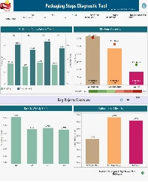
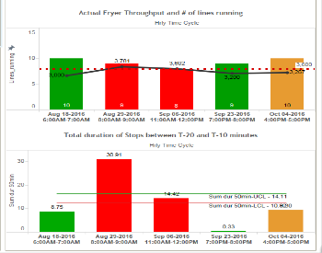

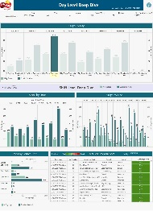



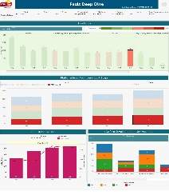



Increasing Manufacturing Throughput
Leading Snack Company
The Problem: Low capacity utilization of expensive equipment that adversely impacts production throughput
The “Before” State
LatentView’s Solution
The “After” State
Large Equipments in the manufacturing line were operating well below capacity and had a high production waste
Early Warning System based on Logistic Regression to predict downtime in processing line
Packaging Stop Diagnostic Tool designed to spot issues
Fryer utilization up to 98.5%
$ 2 million savings in cost per fryer
Reduction in total stops
Optimized scheduling by monitoring individual line
Phase 1
Phase 2
Data Preparation
Model Building
Real Time Dashboard
Data Aggregation
Identify Key Metrics
Tool Development
Packaging Stops
Through put change
Processing Stops
Operational Variables

Slide 18
Leading Home Repairs Company

Slide 19





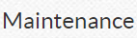



Client Overview
Client is America's largest product repair service provider
Has active relationships with more than 35 million households
Delivers a broad range of retail-related residential and commercial services
Includes Home improvement services (cabinet re-facing/ kitchen remodeling) & Maintenance Services (preventive maintenance)
Over 13 million people covered by Sears protection agreements
Fix any appliance regardless of where the purchase was made
Home upgrades, remodeling and improvements
Highlights
Extending life of HVAC, appliances & lawn & garden tools

Slide 20
Business Impact
Goal
Complete 95% of service requests in 5 days
Demand
Forecasting
Workforce
Planning
Inventory
Planning
Advanced
Diagnostics
Business Process
Lower service levels and less responsive to actual demand
Delay in tech allocation and scheduling
Sub-optimal part assortment
First time incompletes
Identify Service Drivers
More granular forecasting to match supply
Optimize tech allocation for granular demand
Optimize truck stock and order – tech – part match
Utilize service order data for advanced diagnostics
Analytics Powered Solutions
Accuracy up to 92% from 65% reducing lead time by 20%
USD 5 million per annum in incremental revenue as a result of reduced cancellations
4% increase in first time completes
10% reduction in reschedules, resulting in lower trips per repair
Impact

Slide 21
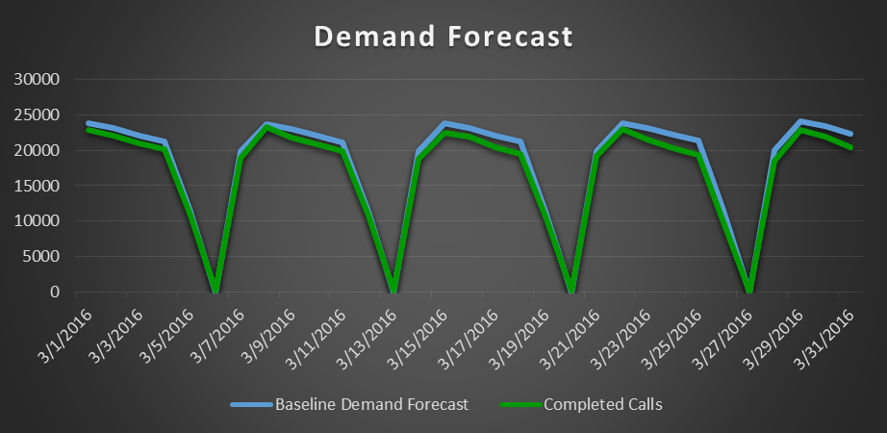
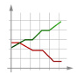



Supply Chain : Demand Planning & Forecasting
Business Problem:
Improve accuracy of Demand Forecast by reducing mismatch at various market segments,
Avoid over-staffing as a result, and
Allocate resources optimally with least Response Time
Output
Demand Forecasting
Demand Forecasting
Deliver the Weekly Demand Forecast of Service Orders for the next 18 Months by Geography, Product Category and Repair Type (Preventive Check/ Break Fix)
By Geography
Data Preparation
Exploratory Data analysis
2 – Year Historical Week Level Call Data
Segmentation
Zip code, Product Category, Payment Method
Business Impact
By Product Type
Improved Demand Forecast Accuracy from 65% to 92%
Automatically re-forecast demand based on actual results and user-managed demand curves
Forecasting & Validation
Multivariate time series model considering holidays and other external factors
By Service Type
Future demand is planned for specific- Season, Geography, Product Category and Customer Types

Slide 22




Supply Chain : Supply Planning & Optimization
Workforce Optimization
Business Impact
Project supply based on Efficiency factors of techs, expected demand and availability of service technicians
Capacity Metrics
Identify Gap/Surplus between demand and optimized capacity at each market segment level
Reduce Idle Capacity and Ensuring minimal gaps in high Demand geographies
Insights & Reporting through web tool and enable Analysts to provide commitments to meet Weekly Demand
US $5 million per annum in incremental revenue as a result of reduced cancellations
Full Time Equivalents
Model Inputs to Optimizer
Availability of Technician
Time taken to complete
Case load
Overall Capacity
Tech Efficiency
Tech Avaliablity Period
Optimize Supply
Analyze technician availability and historical cycle times to build the overall Capacity
Tech Skills
Run a Quadratic optimization model using Solver in Python to minimize Gap/Surplus and Optimize workforce supply

Slide 23

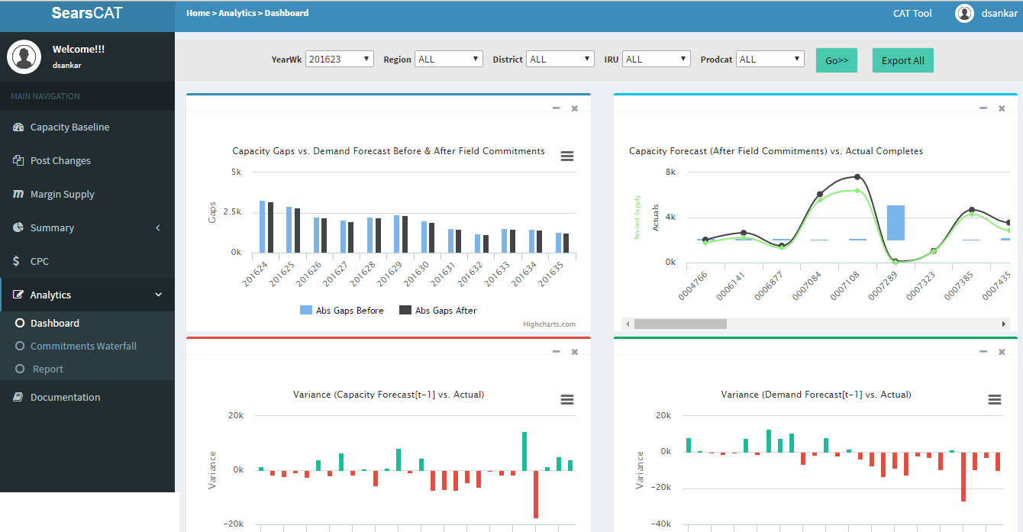
Supply Chain : Dynamic Capacity Reallocation
Enable Reallocation of Capacity on changing Demand
Business Impact
Identify Gap/Surplus between demand and optimized capacity at each market segment level and help plan by Reducing Idle Capacity and Ensuring minimal gaps in high Demand geographies
Internal Data
Enabled identification of opportunities worth an additional US$300,000 every year
The annual savings in capacity management were increased by US $ 25,000 every year.
Provide insights on metrics like Response Time, Trips per Repair, Gap/Surplus at each market segment
Demand Forecast
Data warehousing
ETL process setup to
synchronize
Response Time
Develop & Maintain the analytics interface
Overall Capacity
Gaps/Surplus
Operational LP analytics and Validation
Setup & maintain a data mart in SQL server
Recommended Actions
Identify Gap/Surplus between demand and optimized capacity at each market segment level

Slide 24
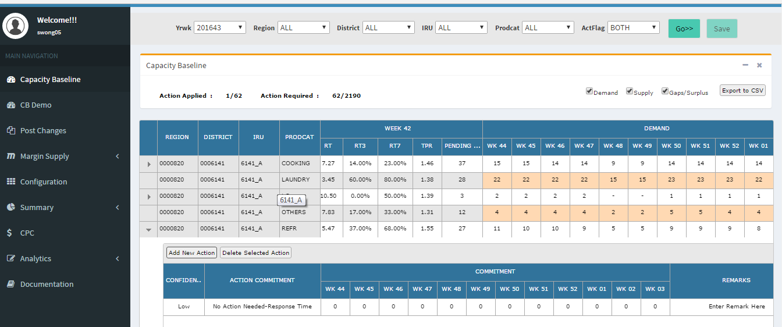
Supply Chain : Dynamic Capacity Reallocation
Displays Demand, Supply projections, response time to new service requests by week for the next quarter
Capacity Baseline Tab

Slide 25


Supply Chain : Inventory Planning
Truck Stock Optimization
Business Impact
Ensure that the right technician with the right parts in service van is dispatched in the first attempt to service a request
Servicing Profitablity Metrics
Develop an integrated service technician profile and parts planning process based on analysis
Establish planning geographies as foundation for profile and parts planning methodology
Optimize truck stock assortment process
Reduce cost involving multiple attempts on a service request
4% Increase in First Time Completes
Identify Key variables for model
Margin
Expected number of first time fixes
No. of requests assigned
Recalls and Reschedules Rate
Expected Profit Generation
Data Mining & Model Building
First Time Completes Rate
Model Validation & Refresh
Output
Assortment of Part level information to be carried in each truck for achieving first time fixes subject to maximized profit

Slide 26

Focus Area : Advanced Diagnostics
Business Impact
Advanced Diagnostics
Enabled client to convert text data into quantitative numeric metrics
The output was a simple binary array which was easily consumable
Multiple symptoms could be viewed and addressed simultaneously
The output was used as a variable to run a model to minimize the time consumed for various services by predicting the parts to be ordered for the service
10% Reduction in reschedules, resulting in lower trips per repair
Advanced Diagnostics
Classifying customer descriptions about various symptoms under different predefined dimensions (attributes) to identify which parts might be needed to complete each Service request
Product Related Info
Data Cleaning and Bi-gram generation
Cosine Clustering and categorization
Mapping cluster categories to original symptoms
Problem Description
Service Type
Final Output
SYMPTOMS | Heating issues | Drying issues | Noise issues
NDCS/NOT GETTING HOT NOT DRYING | 1 | 1 | 0
NOT DRYING MAKING LOUD SCREECHING NOISE | 0 | 1 | 1
Predicting service request parts by using symptoms as one of the IDV's

Slide 27
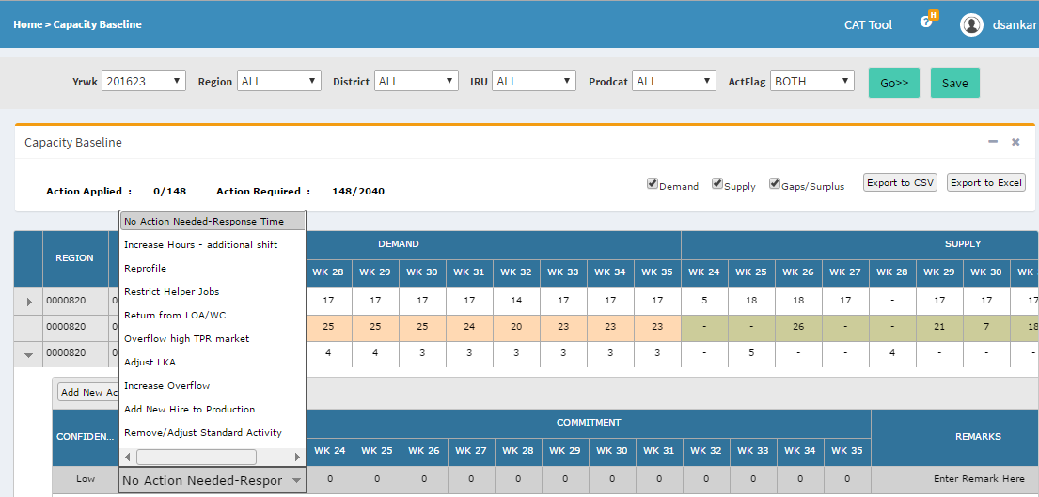
Interactive Dashboard for Capacity Analysts / Managers - CAT
Enabling Capacity Analysts at Sears to distribute workforce optimally
Provide insights on metrics like Response Time, Trips per Repair, Gap/Surplus at each market segment
Enable Analysts to provide commitments for their territory in the next 3 months to meet Weekly Demand
Also tracks accuracy and fulfilment of commitments provided in previous weeks.
Reporting on Call Margins, Weekly summary of Demand Met and Interactive Dashboard to analyze Accuracy
Benefits:
Provide a Quarterly overview of Gaps/Surplus between Demand & Supply to plan for Capacity augmentation, if needed
Identify markets segments with surplus & high margins post optimization to tap growth opportunities

Slide 28
Interactive Dashboard for Capacity Analysts / Managers - CAT
Capacity Baseline Tab
Displays Demand, Supply projections, response time to new service requests by week for the next quarter
Enables filter by each market segment (Geography X Product Category)
All views can be exported to excel
Actions and remarks on plan to address deficit capacity or utilize surplus

Slide 29
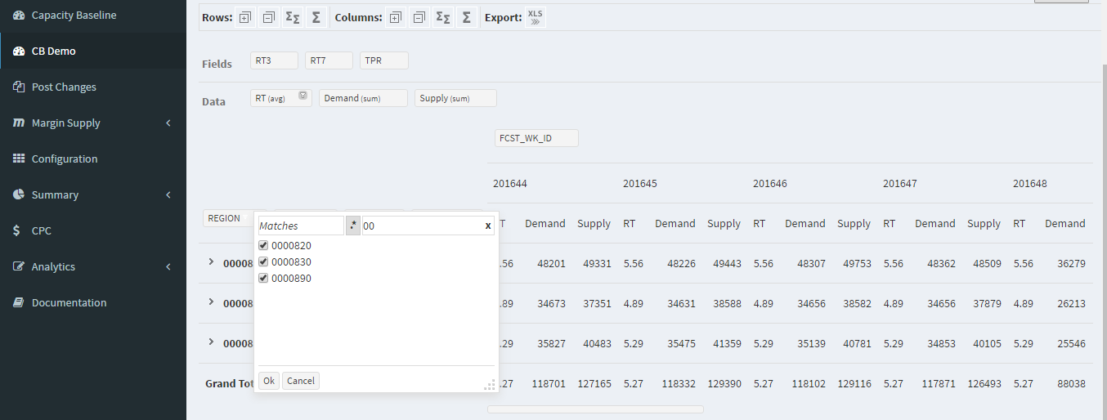
Interactive Dashboard for Capacity Analysts / Managers - CAT
Pivot Version of Capacity Baseline
Customizable Dimension and metrics to give a playbook view of Demand - Capacity data (Mimics pivot table in excel)

Slide 30
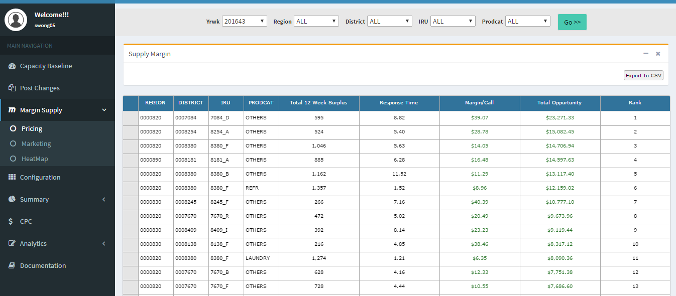
Interactive Dashboard for Capacity Analysts / Managers - CAT
Margin Supply-Pricing Tab
Provides a ranked view on marketable surplus by market segment and also dollar value of opportunities utilizing surplus.

Slide 31
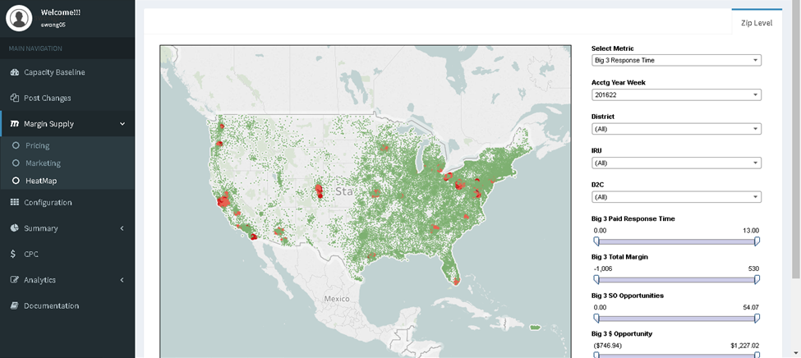
Interactive Dashboard for Capacity Analysts / Managers - CAT
Metrics and fields which can be filtered and viewed on a geographical map
Margin Supply- HeatMap Tab
A tableau Heat Map built and embedded to provide response times by market and serviceable opportunities. Areas in red indicate bad response time

Slide 32
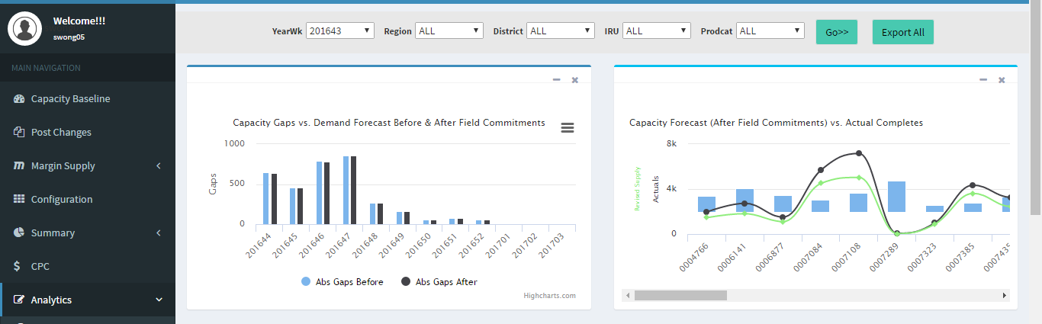
Interactive Dashboard for Capacity Analysts / Managers - CAT
Analytics-Dashboard Tab
As the Capacity Analysts input actions to reduce Gaps (demand-supply), the chart is updated to reflect the Gaps look before and after adding actions on real-time
Accuracy of Supply projections by district. Blue histogram represents accuracy (%), Black trendline - Actual value at end of week. Green trendline - Projected value.

Slide 33
Leading Pharmaceutical Company

Slide 34
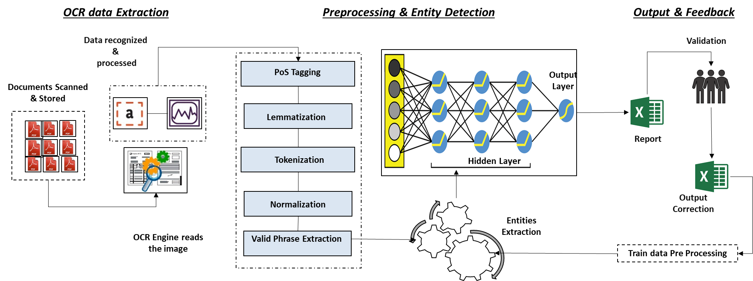
Using AI To Extract Actionable Insights From Documents
Leading Pharmaceutical and biopharmaceutical Company in UK
The Problem: Engagement with vendors across the globe has made review of contracts highly time consuming & labor intensive thereby leading to increased expenses associated with review , maintenance and administration of contracts on day-to-day basis.
The “Before” State
LatentView Solution
The “After” State
Business users are required to first search & identify required documents from two different source systems. And post identification, manually read through & extract required information from contracts for any review or analysis.
Developed a comprehensive view of contracts by automatically extracting & highlighting key provisions that are important to business users using industry-leading machine learning and natural language processing technology(NLP)
Automated solution for entity extraction has helped in reducing the time & cost by ~10 times.
Inbuilt exception module enabled users to validate any risks or erroneous data on priority.
Model Enrichment through automated feedback mechanism ensured model is continuously trained even by non technical users.
LatentView Solution workflow

Slide 35
AI Driven Solution
3 step approach for building the solution
Pattern Matching
NLP
Combination of “Regex + Fuzzy Logic” for checking & locating specific entities
Entities are completely detected using NLP models
Pattern Matching + NLP
“Pattern Matching” & “NLP” models used side by side for detecting entities

Slide 36
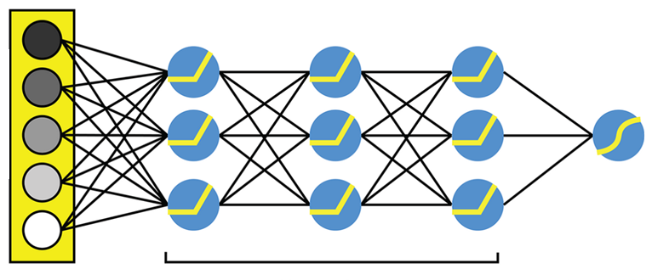






3 Stages of Solution Workflow
Data recognized &
processed
Validation
PoS Tagging
Output
Layer
Documents Scanned & Stored
Lemmatization
Report
Tokenization
Hidden Layer
Normalization
Output
Correction
Entities
Extraction
OCR Engine reads the image
Valid Phrase Extraction
Train data Pre Processing
OCR data Extraction
Preprocessing & Entity Detection
Output & Feedback
Conversion of input files to txt format. Current solution can handle following document formats
Selectable pdf & OCR based pdf
doc/doc
png/jpg/tiff
Data cleaning & standardization to ensure clean data is fed into the Deep learning model for entity detection.
This ensures unnecessary noise is reduced in the output
Excel report is generated with answers for all business queries
Post user validation the data is automatically processed and fed back into model

Slide 37
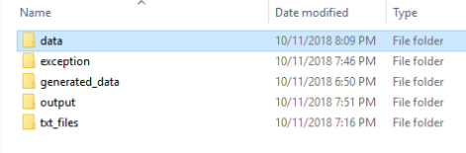
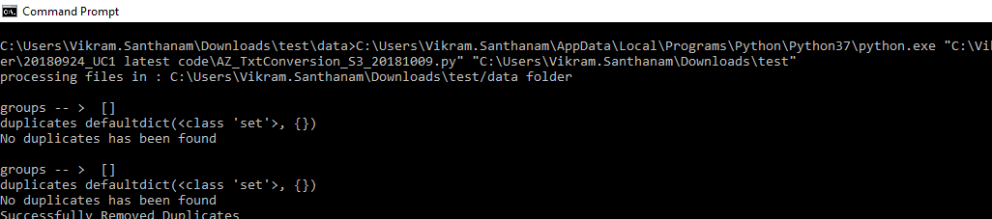
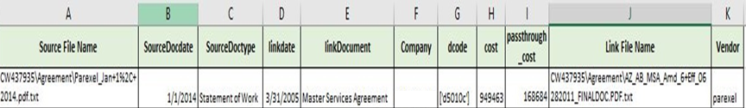
Tool Snapshot-Overall
Data loading
Code Execution
Output

Slide 38
Leading Fashion E-Commerce Company

Slide 39
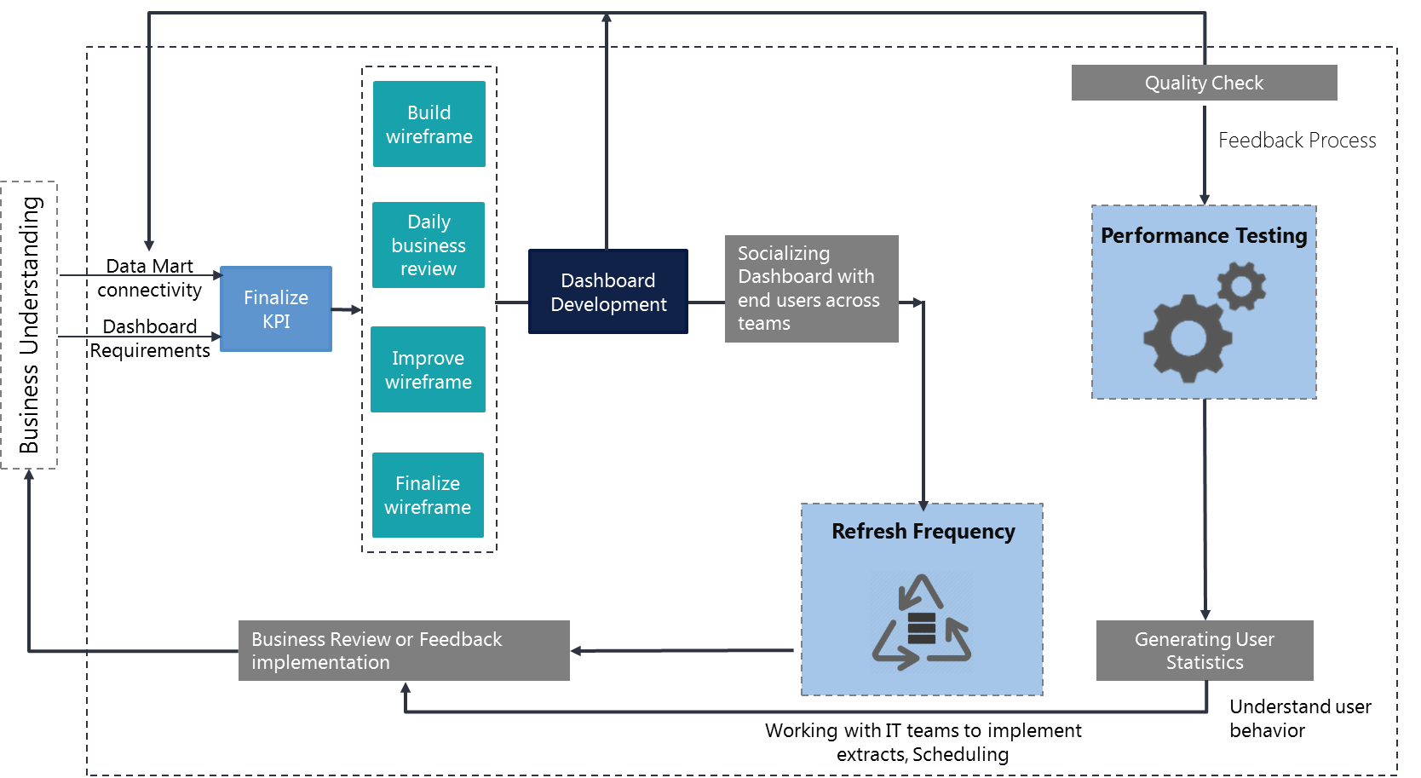
Control Tower Visualization
Client wanted to monitor key metrics in a reliable, consistent and accurate manner for the following functional areas:
Supply Chain
Customer Experience
Platform Experience
Scope of the services
Latentview proposes to build a highly scalable, available data platform on Azure with a highly responsive web application.
Framework for building the dashboards

Slide 40
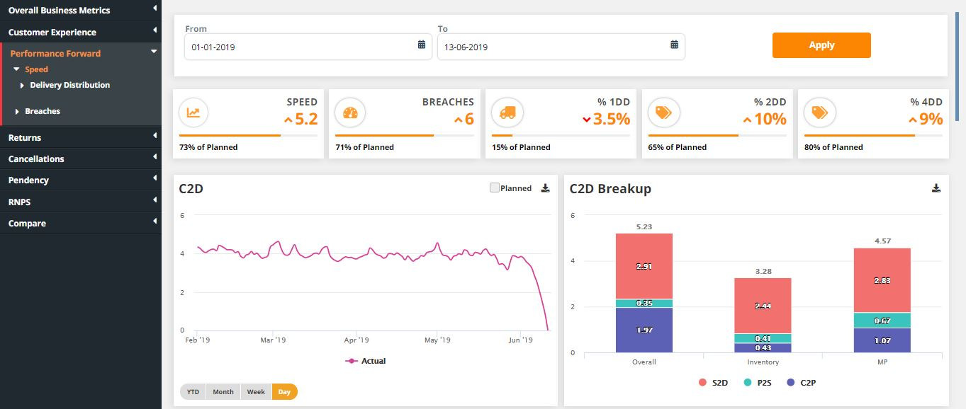
Custom Tool – Screenshot #1

Slide 41
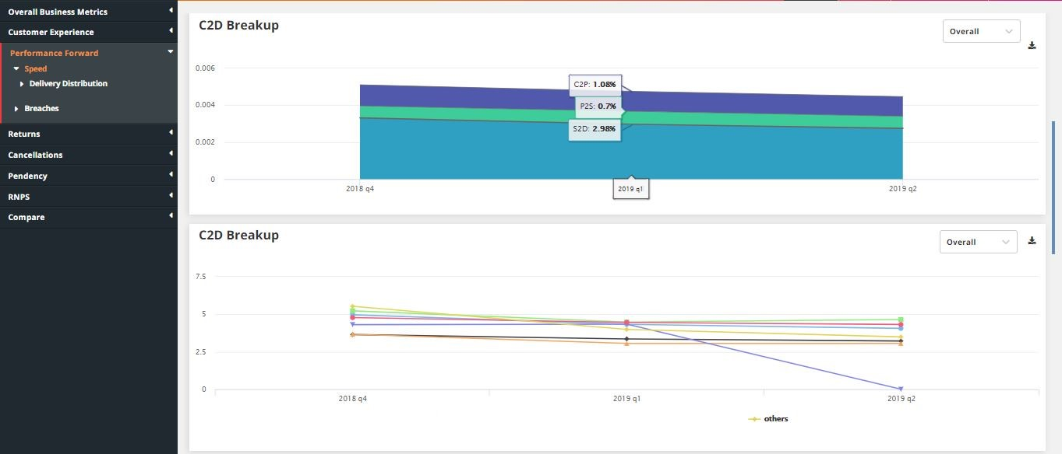
Custom Tool – Screenshot #2

Slide 42
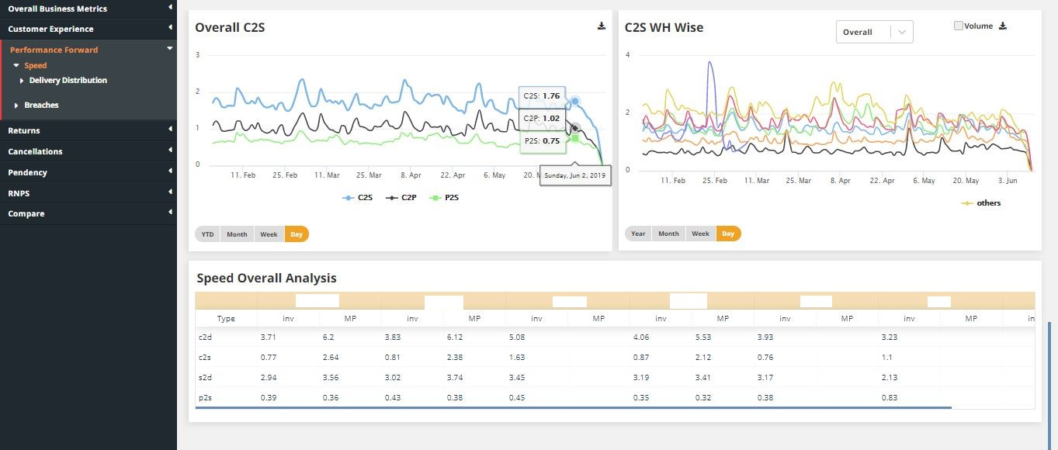
Custom Tool – Screenshot #3

Slide 43
Thank You

Slide 44
Appendix

Slide 45


































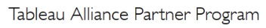
Tools, Technology & Partnerships
Data Engineering
Data Science & Modelling
Data Visualization
Tableau
Measurement Partner
Alliance Partner

Slide 46











Expertise in Cloud Platforms
LatentView is a Microsoft Gold Analytics Partner
Model Automation Framework – LatentView scalable ML solution built in Azure hosted on Microsoft Appsource (link)
Managed Analytics in Azure using AzureML, PowerBI, Azure data factory, Azure Search, Azure data lake analytics etc.
Extensive experience in handling GCP products- AppScript, CloudSQL, Appmaker, Big Query etc. Deep Technical Capabilities to work in this platform
Multiple solutions deployment experience for Google projects
Managed Analytics in GCP using MapR, Cloud ML, Cloud dataflow, Google data studio, Cloud SQL
LV is Advanced Analytics Consulting Partner
Key Presenters of AWS Re-Invent, Business Summit
400 TB cloud migration exercise completed in 3 months
Processing 500+ GB unstructured data per week
Multiple enterprise solutions deployment experience
Managed Analytics in AWS using Amazon ML, Cloudsearch, Kinesis, QuickSight etc.

Slide 47








Service offering spectrum
Functional categories
Enablers
Customer Analytics
Marketing Analytics
Supply Chain
Finance And Risk
HR Analytics
CFO Dashboards
Employee Pulse and Retention
Customer Perception
Brand and Competitive
Positioning
Sourcing and
Replenishment
Customer Behavior
Collection Analytics
Talent Acquisition
Campaign Design and Effectiveness
Metrics
Measurement
Trust/Counterfeit
Analysis
Performance and Compensation
Lifetime Value Analysis
Marketing Spend Optimization
Demand-Supply Forecast
Loyalty and Personalization
Attribution Modelling
Inventory Optimization
Personalized Marketing
Innovation
Administration
Cross Sell/Up Sell
End to End Visibility
Innovation Radar
Asset Optimization
Data Engineering
Business-focused Approach to Data Engineering to help adopt modern scalable architectures
Visualization
Reporting and dashboards platforms for Insights and quick view on KPIs

Slide 48

Demand & Supply Optimization
1
Model Inputs to
Optimizer
2
Optimize Supply
3
ETL and Analytics Interface
Availability of Technician
Overall Capacity
Linear Programming Model
Data warehousing
Use of LP Optimization Engine built in Python
ETL process setup to
synchronize
Time taken to complete
Case load
Model Validation
Demand Forecast
Use optimized supply to provide Analysts with insights & enable them to take actions
Develop & Maintain the analytics interface
Objective
Solution
Business Benefits
Enable operations team to plan allocation of technicians and distribute workforce optimally
Problem: Minimize the Gap/Surplus between Demand and Capacity at each Market Segment across the country
Develop a web application enabling a centralized workforce planning mechanism
Analyze technician availability and historical cycle times to build the overall Capacity
Linear Optimization in Python to minimize Gap/Surplus and Optimize workforce supply
Setup & maintain a data mart in SQL server
Developed a web application in ASP.NET MVC to facilitate capacity analysis
Identify Gap/Surplus between demand and optimized capacity at each market segment level
Reduce Idle Capacity and Ensuring minimal gaps in high Demand geographies
Insights & Reporting through CAT tool and enable Analysts to provide commitments to meet Weekly Demand

Slide 49
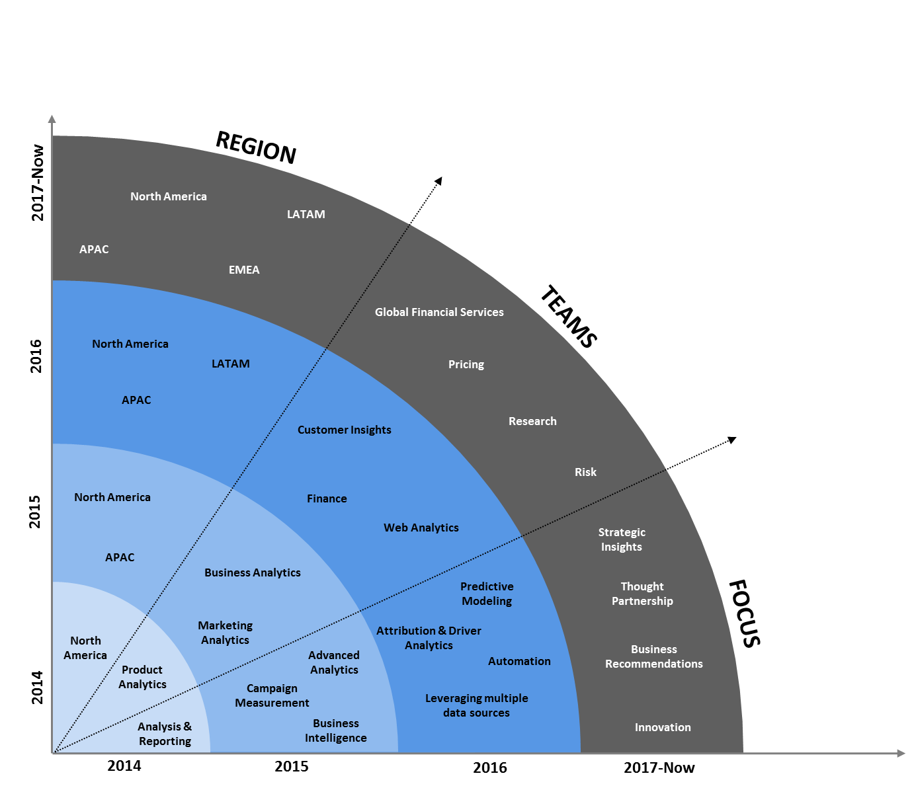



Multi-Year CoE with Leading Payments Provider
Solutions by Business Unit
A single view of campaign performance aggregated at a across geographies that can be drilled further into programs, channels, campaigns according to user role
Marketing Analytics
Customer acquisition and activation journey from TOF to Conversion visualized through Tableau funnel dashboards
Web Analytics
Understand drivers of customer engagement and uncovering factors driving business /product performance.
Consumer
Insight

